Slide 1
AIML
Project
Project Name: Celebrity Face Recognizer
Team Details:
Gursimran Kaur (2210990350)
Himanshu Kohli (2210990404)
Kunisha Dhir (2210990528)
Pinak Dhir (2210990650)
Supervised By: Tushar Khitoliya
Chitkara University Institute of Engineering and Technology,
Chitkara University, Punjab

Slide 2
Table of Contents
Introduction
Problem Statement
Technical Details
Key Features
Project Highlights
Conclusion
References/Links used

Slide 3
Introduction
For social media, entertainment, and security, celebrity face prediction is crucial, yet image fluctuations provide difficulties. The benefit of machine learning is that it can accurately recognise faces by analysing photos and extracting information. The project's goal is to create a trustworthy machine learning (ML) system for celebrity face detection. This system's strong capability will be useful for social media analysis, entertainment, and security applications.

Slide 4
Problem Statement
It can be difficult to accurately recognise famous faces in images or videos because of variations in lighting, image quality, and facial features. Key facial characteristics that set superstars apart from the general public must be the focus of effective face recognition systems. Reliable celebrity face recognition algorithms are necessary to enhance user experiences on social networking, entertainment, and security platforms. The assessment of image data, the discovery of noteworthy traits, and the development of exact models for reliable celebrity face identification are all made possible by machine learning techniques.

Slide 5
Modules Used:
1.OpenCV (Open Source Computer Vision Library): OpenCV is a popular open-source library for computer vision and image processing tasks. It provides a wide range of functionalities for tasks such as image and video manipulation, object detection, feature extraction, image stitching, and more.
2.Matplotlib: Matplotlib is a comprehensive plotting library for creating static, interactive, and animated visualizations in Python. It provides a interface for generating plots and charts, allowing users to create line plots, scatter plots, bar plots, histograms, etc.
3.NumPy (Numerical Python): NumPy is a fundamental package for numerical computing in Python. It provides support for multidimensional arrays, mathematical functions for array manipulation, linear algebra operations, Fourier transforms, random number generation

Slide 6
4.Seaborn: Seaborn is a statistical data visualization library built on top of Matplotlib. It provides a high-level interface for creating attractive and informative statistical graphics. Seaborn simplifies the process of creating complex visualizations such as heatmaps, violin plots, pair plots, and categorical plots.
5.Pandas: Pandas is a powerful data manipulation and analysis library for Python. It provides data structures and functions for working with structured data, including labeled arrays (DataFrames) and labeled one-dimensional arrays (Series).

Slide 7
Key Features
Organise a collection of images that is diverse and clearly labels well-known faces from less-known ones.
To increase model generalisation, preprocess photos using scaling, normalisation, and improvements.
Utilising preprocessed data, train the model and tweak its hyperparameters to improve face detection precision. For efficient celebrity face identification, assess model performance using measures like as accuracy, precision, recall, and F1-score.
In order to retain accuracy in real-world applications and adjust the model to changing picture properties, implement continuous monitoring and updates.

Slide 8
Conclusion
To guarantee accurate celebrity face identification, assess model accuracy using thorough assessment measures. To find the most effective strategy for identifying celebrities' faces while maximising performance and dependability, compare and evaluate a variety of machine learning algorithms and techniques. Showcase the face detection model's usefulness and adaptability in a variety of contexts, including security systems, social networking sites, and the entertainment industry. Emphasise how this model may improve usability and functionality. Maintain good performance over time by regularly assessing the model's accuracy, flexibility, and stability with fresh data and changing image attributes. To create new benchmarks for the industry, investigate how the celebrity face detection model can revolutionise security procedures, provide cutting-edge capabilities to a range of apps, and greatly improve user experiences.

Slide 9

Highlights Of The Project

Slide 10


Slide 11
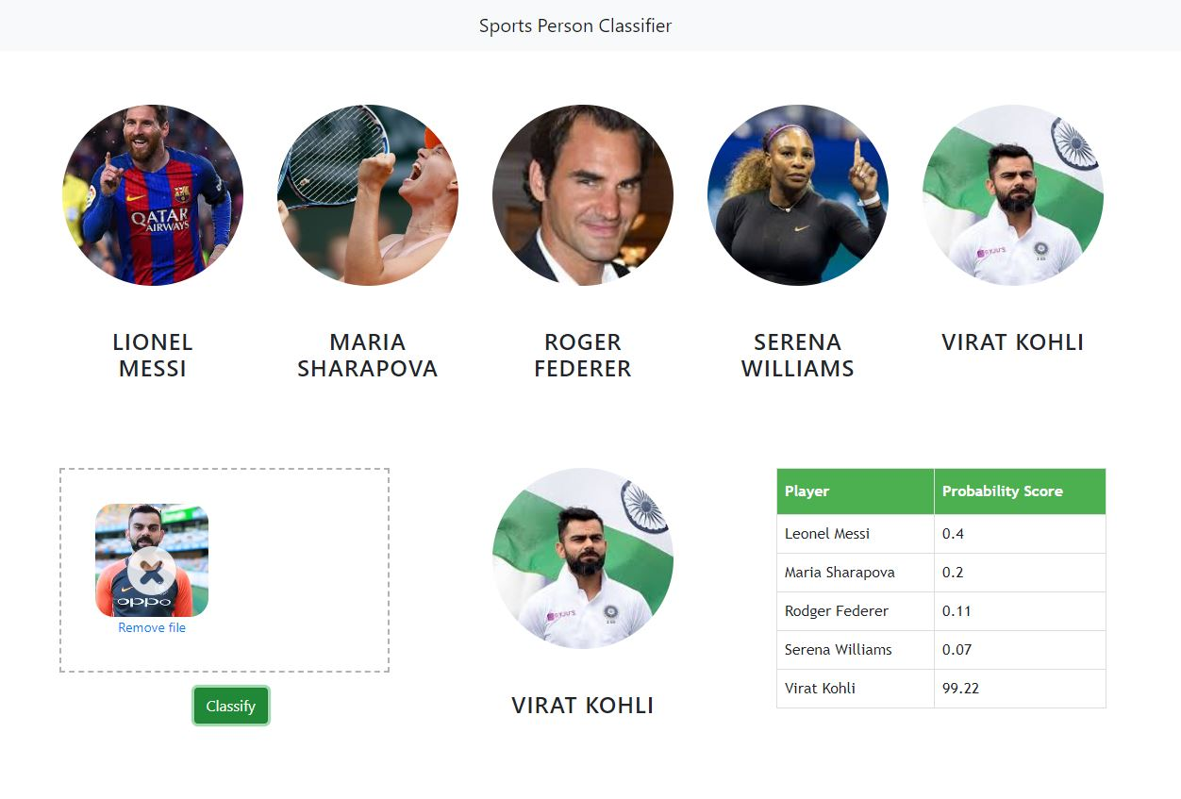
Highlights

Slide 12


